Slide 1
Solid Principles

Slide 2
Objectives
To understand the main principles of SOLID
Contents
Single-Responsibility Principle
Open/Closed Principle
Liskov Substitution Principle
Interface Segregation Principle
Dependency Inversion Principle
Follow these principals for good design and code

Slide 3
Single Responsibility Principle
Each class/method should have only one responsibility
No 'Kitchen Sink' classes! A class called QA which runs the QA training!
This principal promotes decoupling
It is a lot easier to write code and change it if a class does only one thing
Code is reusable; by combining responsibilities other classes won’t be able to use a single responsibility from the class.
Very large classes usually have multiple responsibilities
Break it up into smaller classes which in turn makes the class easier to test.

Slide 4
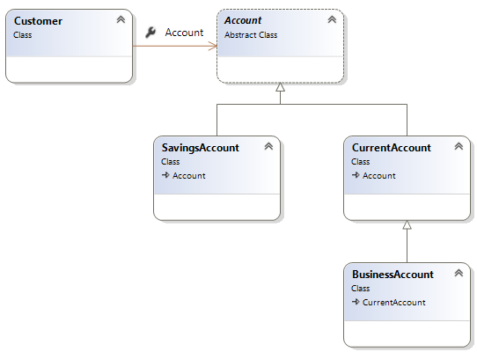
Open Closed Principle
Open for extension, closed for modification
Classes should be extendable, but not modifiable
Changes in requirements are performed using extension rather than by modifying existing classes
Apply abstraction and polymorphism.

Slide 5
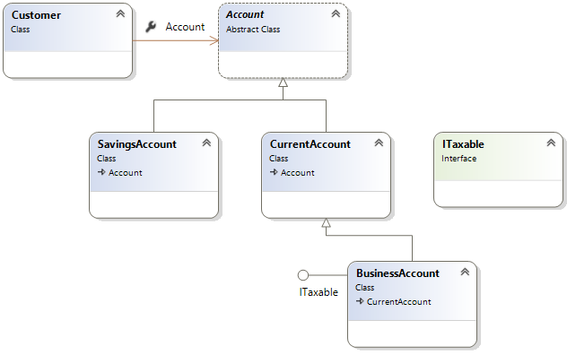
Open Close principal example and using Interfaces

Slide 6

Sub-classes behaviour should be the same as the super-classes
Should fulfil all behaviours of the base class correctly
The behaviour of a derived class should have a stronger post-condition and a weaker precondition than the base class.
(you'll see this in the next few slides)
This principal prevents classes having undesirable behaviours.
Liskov Substitution
Barbara Liskov

Slide 7
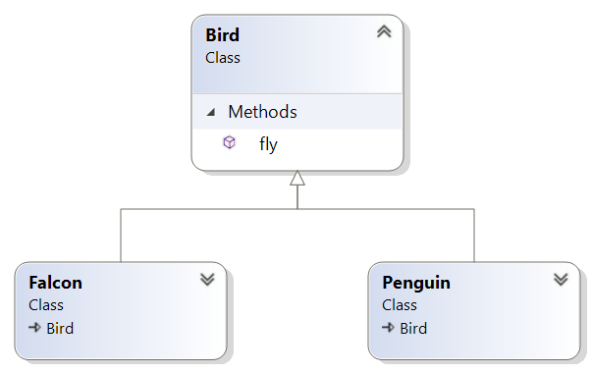


Let’s break Liskov’s principle!
Bird[] birds = { new Falcon(), new Penguin(), new Falcon() };
for (int i = 0; i < birds.Length; i++)
{
birds[i].fly();
}

Slide 8
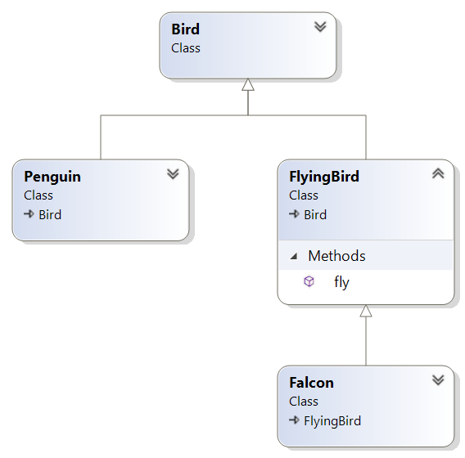
Let’s apply Liskov’s principle

Slide 9
High-Level modules should not depend on low-level modules – both should depend on abstractions
Abstractions should not depend on details. Details should depend on abstractions.
Instead of working with hard-wired / highly coupled classes you should always attempt to use interfaces
Let's have a look at a simple example
Dependency Inversion Principle (DIP)
Notes:
You can think of DIP as being an outgoing interface of the ‘dependent’ class rather than an incoming interface of the dependee class. You have to try and establish the abstraction that underlies the application – that set of concepts and behaviours that doesn’t vary when the details are changed.
This is such an important principle that a mechanism has been subsumed into the .NET framework – delegates do exactly this.
It is also sometime known as “The Hollywood Principle” – don’t call us, we’ll call you.

Slide 10
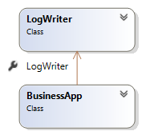
DI example – Inflexible design
The following code logs a message in a console
But the class BusinessApp has a dependency on the class LogWriter
This violates the DI principle. What if you want to send email instead?
class LogWriter {
public void Write(String message) {
File.AppendAllText("Log.txt", message);
}
}
class BusinessApp {
LogWriter logger = new LogWriter();
public void Log(String message) {
logger.Write(message);
}
}

Slide 11
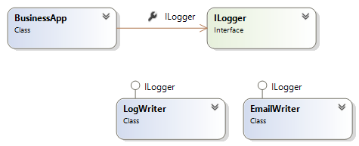
Better design but can improve
interface Ilogger {
void Write(String message);
}
class LogWriter : Ilogger {
public void Write(String message) {
File.AppendAllText("log.txt", message);
}
}
class EmailWriter : Ilogger {
public void Write(String message) {
Outlook.Send("admin@qa.com", message);
}
}
class BusinessApp {
ILogger logger;
public void Log(String message) {
if (logger == null)
logger = new LogWriter();
logger.Write(message);
}
}
Could improve!

Slide 12
Dependency Injection
Is for injecting the concrete implementation into a class that uses an abstraction (like an interface)
Dependencies can be injected into a Method/Constructor/Property
public class BusinessApp
{
ILogger logger;
public BusinessApp(ILogger logger)
{
this.logger = logger;
}
}
static void Main(String[] args)
{
BusinessApp app = new BusinessApp(new EmailWriter());
// other code
}

Slide 13
Interface Segregation
Interfaces should be specific to a client.
Many specific interfaces are better than one general purpose interface.
Using specific interfaces makes the required client behaviours clear.
It also improves usability since implementers include only the behaviours they need.
Let's have a look at an example…

Slide 14
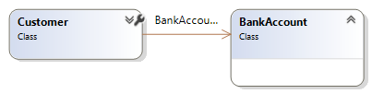
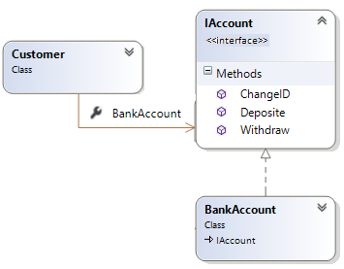
Customer association to a bank account
First attempt: What could be the problem with this design?
Second attempt: Is this solution better? Why?
Yes! Customer can extend another class
But what could be a problem with this solution?

Slide 15
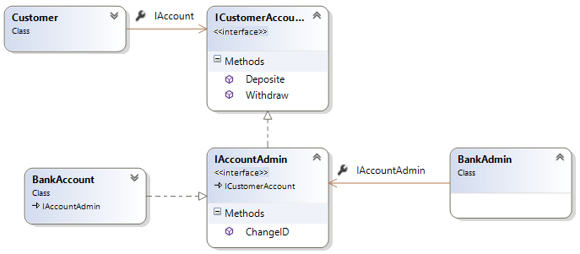
Third attempt – Create many interfaces
We should not allow customers to change their account ID!
Give customers their own account interface
The admin app can change IDs and has the same capabilities as a customer

Slide 16
Patterns
What is a pattern?
Is a general reusable solution to a commonly occurring problem within a given context
Provides a template for solving problems
Creates a communication shortcut with other designers and speed up the development process

Slide 17

A few common patterns
Singleton
This pattern is used to create a single instance of a class in your application
For example, there should only be one Game object in a Game application, One Bank object in an application about Bank
Factory
Creates other objects
Often used with a Singleton patterns because one instance of factory will be enough in most applications
Composite
Treats individual objects and compositions of objects uniformly
Decorator
Attach additional responsibilities to an object dynamically keeping the same interface. Provides a flexible alternative to sub-classing for extending functionality.
There are many more
See here for more information: https://refactoring.guru/design-patterns/csharp

Slide 18
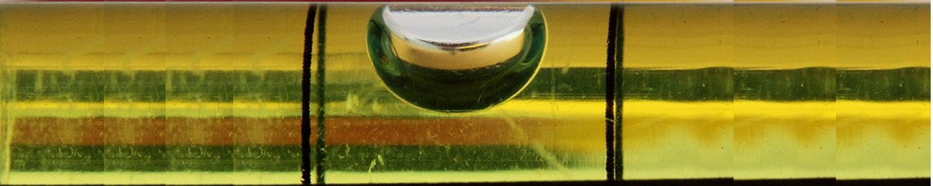
Design Patterns embody principles
They are a great way of grasping and implementing principles in your design/code
You have to strike a balance between:
How do you find that balance? – next slide…
Too simple Easier to hack than follow the design Rigid/Fragile/Repetitive etc.
Needless Complexity

Slide 19
…by Unit Test
Exposes software that should be de-coupled
We naturally put responsibilities together
In Software design we separate the responsibilities that are subject to change
You don’t want to do it if the change never happens
When you do have to do it, you want to do this just once
I.e. take the first bullet then refactor so the following bullets don’t hurt
Never say “we’ll come back and fix that later
Agile design is a process, not an event
Unit Test is probably the best tool we have for driving good design

Slide 20

Symptoms of a degrading design
Rigidity, fragility, immobility, viscosity
Degradation of dependency architecture
SOLID

Slide 21
THANK YOU
Hope you enjoyed this learning journey.

Slide 22
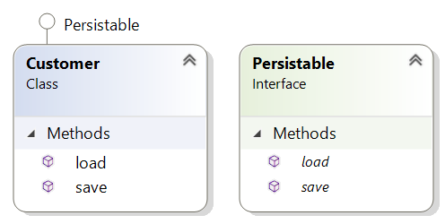
Another example of the Liskov Principle
interface Persistable {
void save();
void load();
}
class Customer implements Persistable {
int id;
String name;
public void load() {
// Read a data store and set // the ID and Name properties
}
public void save() {
// Save instance properties to a data store
}
}

Slide 23
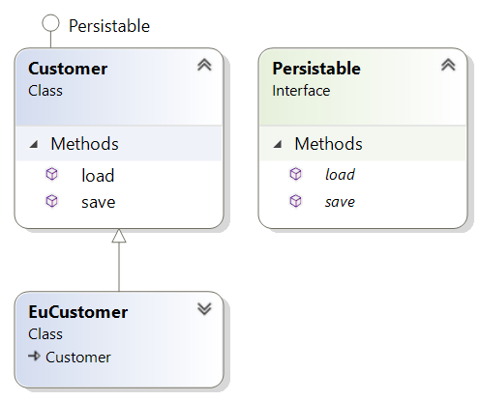
Add a new class called EuropeCustomer
class EuCustomer extends Customer
{
@override
public void save()
{
if (LocalTime.now().getHour() < 12)
{
// Save instance properties
}
}
}
What if the save() method is called in the afternoon?

Slide 24
What if one objects in a List is a EuropeCustomer ?
public class Manager
{
public void SaveObjects(ArrayList<Persistable> objects)
{
for(Persistable item : objects)
{
item.save();
}
}
public void LoadObjects(ArrayList<Persistable> objects)
{
for (IPersistable item : objects)
{
item.load();
}
}
}

